Slide 1



EARTH AND UNIVERSE
By SANSKRITI
www.vaagaacademy.com

Slide 2
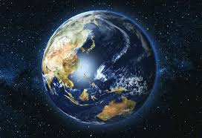
EARTH
Earth is a planet – a huge round ball that we live on 🌏
It has land, water, and air
Known as the Blue Planet because 70% of it is covered in water
🧠 Olympiad Tip: Earth is the only planet with life and water in all three forms.

Slide 3
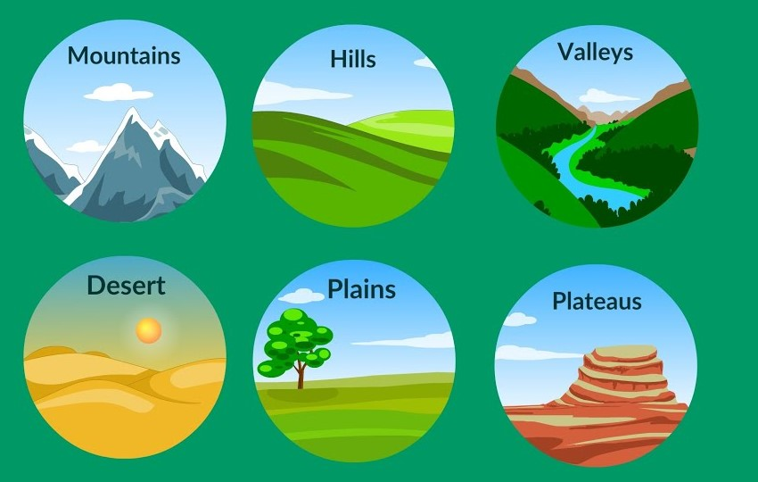
LANDFORMS ON EARTH
Landforms are natural shapes on Earth’s surface:
Mountains – very tall and steep 🏔️
Hills – smaller than mountains ⛰️
Valleys – low land between hills/mountains 🌄
Plains – large, flat lands 🌾
🧠 Question clue: Hills are higher than plains and not as steep as mountains.

Slide 4
Motion of earth
Motion | Description | Result
Rotation | Earth spins on its axis | Causes day and night 🌞🌙
Revolution | Earth moves around the Sun in a path | Causes seasons ❄️🌸🌞🍂
🔁 Earth rotates once every 24 hours, and revolves once every 365 days

Slide 5
WHY SEASON CHANGE?
Seasons change because of the revolution of Earth around the Sun 🌞
Earth’s tilted axis causes sunlight to fall unevenly
🧠 Trick Question Tip: Rotation causes day-night, not seasons!

Slide 6
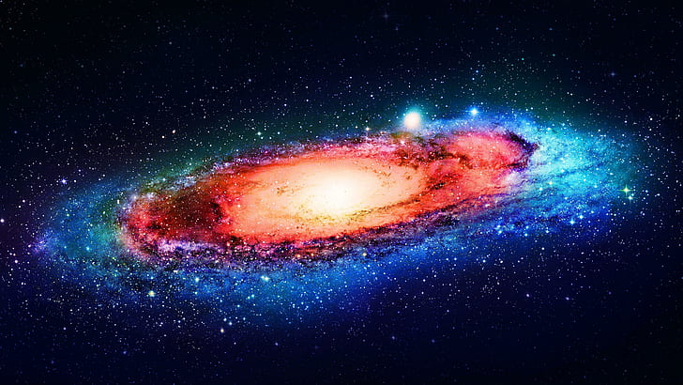
UNIVERSE
Universe = Everything that exists!
Includes:
Stars ✨
Planets 🌍
Moons 🌙
Comets, Meteors, Asteroids ☄️
🧠 Our galaxy is called the Milky Way

Slide 7
Solar system
The Solar System has:
1 Sun – A big star that gives light and heat ☀️
8 Planets – Like Earth, Mars, Jupiter
Moons – Go around planets
Asteroids & Comets – Rocks and icy balls that orbit the Sun
🌟 Earth is the third planet from the Sun!

Slide 8
planets
Order | Planet | Fun Fact
1st | Mercury | Closest to the Sun 🌞
2nd | Venus | Hottest planet 🔥
3rd | Earth | Has life 💙
4th | Mars | Called the Red Planet ❤️
5th | Jupiter | Biggest planet 🌪️
6th | Saturn | Has rings 💍
7th | Uranus | Spins sideways 🤸‍♂️
8th | Neptune | Farthest and coldest ❄️
🎵 Mnemonics help! Example: My Very Educated Mother Just Served Us Noodles

Slide 9
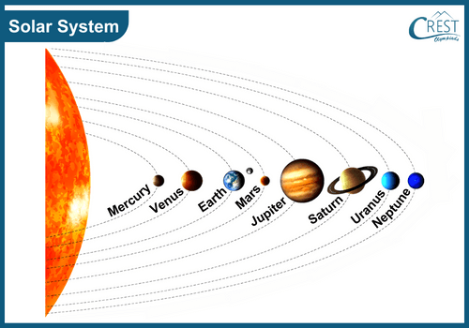

Slide 10
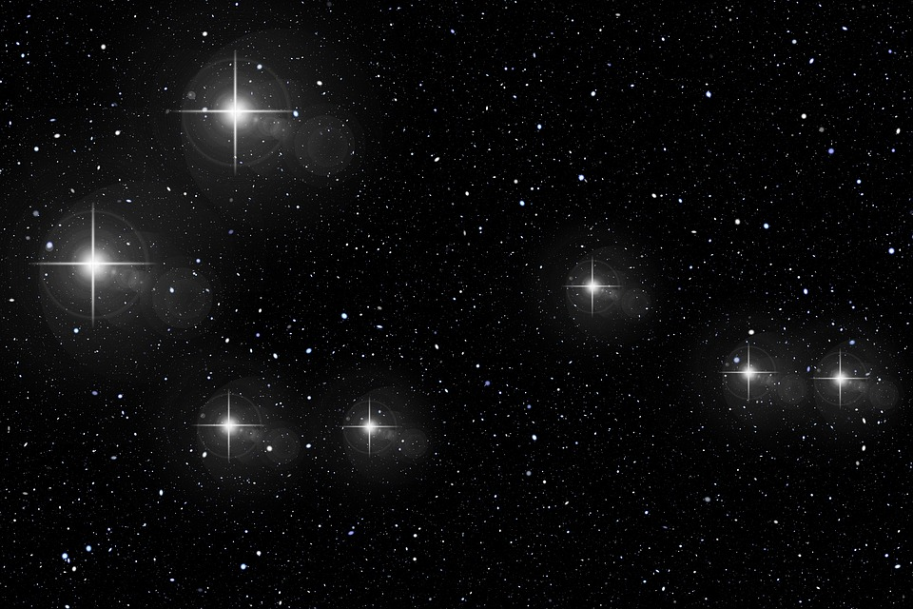
Stars and Constellation
Stars are big hot balls of gas 🔥 (like our Sun!)
Constellations are star patterns in the night sky
Like Ursa Major, Leo, Orion
🧠 Olympiad Clue: A constellation is not a comet or meteor – it's a group of stars!

Slide 11
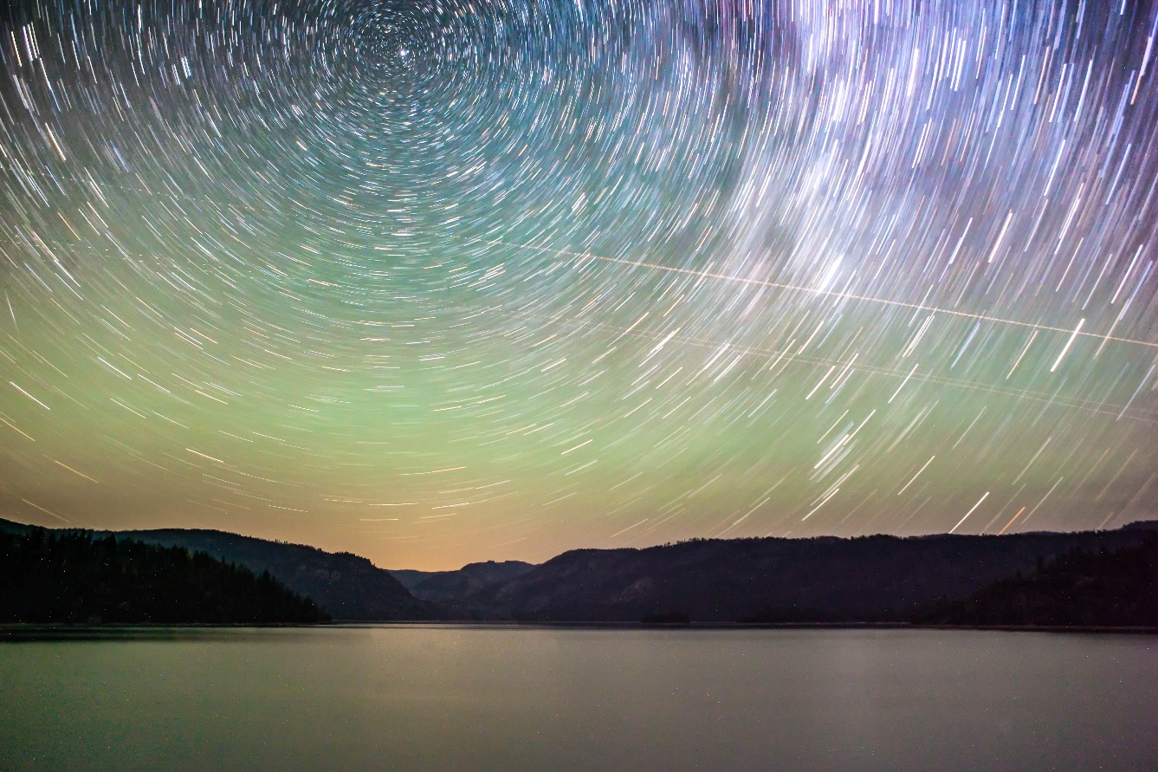
Celestial objects
Object | What is it?
Asteroids | Chunks of rock – orbit the Sun – rocky belt
Comets | Icy rocks with tails – come close to Sun
Meteors | Shooting stars – burn in Earth's sky
🧠 Asteroids mostly live between Mars and Jupiter

Slide 12
THANKS

